Slide 1
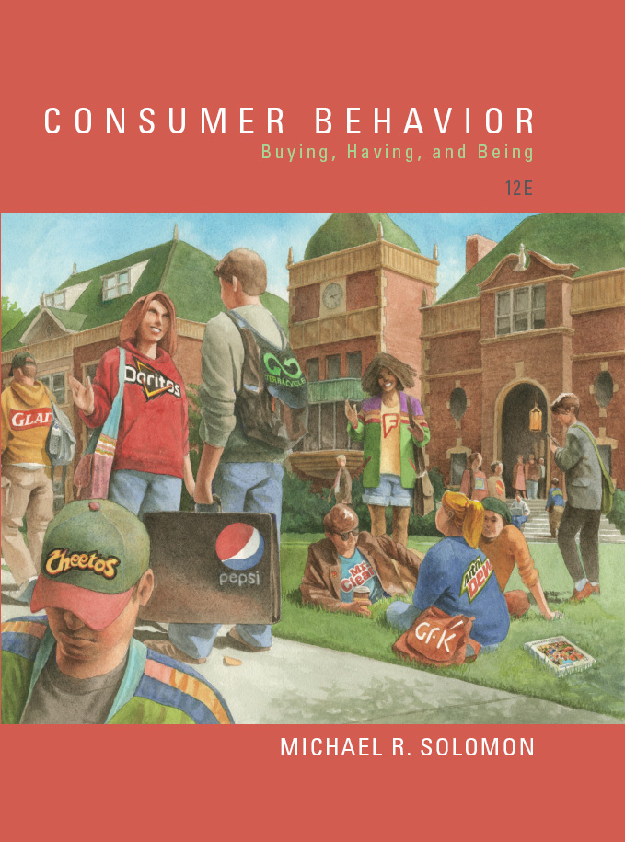
Consumer Behavior: Buying, Having, and Being
Twelfth Edition
Chapter 4
Learning and Memory
Copyright © 2017, 2015, 2013 Pearson Education, Inc. All Rights Reserved.
Notes:
If this PowerPoint presentation contains mathematical equations, you may need to check that your computer has the following installed:
1) MathType Plugin
2) Math Player (free versions available)
3) NVDA Reader (free versions available)
This chapter defines the scope of international business and introduces us to some of its most important topics.

Slide 2
Learning Objectives (1 of 2)
4.1 It is important to understand how consumers learn about products and services.
4.2 Conditioning results in learning.
4.3 Learned associations with brands generalize to other products.
4.4 There is a difference between classical and instrumental conditioning, and both processes help consumers learn about products.

Slide 3
Learning Objectives (2 of 2)
4.5 We learn about products by observing others’ behavior.
4.6 Our brains process information about brands to retain them in memory.
4.7 The other products we associate with an individual product influence how we will remember it.
4.8 Products help us to retrieve memories from our past.
4.9 Marketer measure our memories about products and ads.

Slide 4

Learning Objective 4.1
It is important to understand how consumers learn about products and services
Notes:
Learning is a relatively permanent change in behavior caused by experience. The experience can be direct or it can be observed. Learning is an ongoing process.

Slide 5
How Do We Learn?
Learning
Incidental learning
Notes:
Our senses play quite a role in the decisions marketers make. For instance, marketers rely heavily on visual elements in advertising, store design, and packaging. They communicate meanings on the visual channel through a product’s color, size, and styling. An interest in scent has spawned new products. Some brands utilize scent easily. For instance, Starbucks requires baristas to grind a batch of coffee each time they brew a post instead of just once each morning to ensure customers have that intense smell during their Starbucks’ experience. Stores and restaurants often play certain kinds of music to create a certain mood. Recent research found that participants who simply touch an item for 30 seconds or less had a greater level of attachment with the product. This connection in turn boosted what they were willing to pay for it. A food item’s image and the values we attach to it influence how we experience the actual taste. These aspects can be called a brand’s sensory system. We’ll cover these 5 aspects of branding in learning objectives one and two.
Hedonic consumption includes how consumers interact with the emotional aspects of products. In other words, products are rarely strictly functional. Consumers may want hedonic value too. Target is a company that has embraced this insight. Target focuses on products with great design as well as functionality.
The Coca-Cola bottle also illustrates an example of how design can facilitate product success.

Slide 6
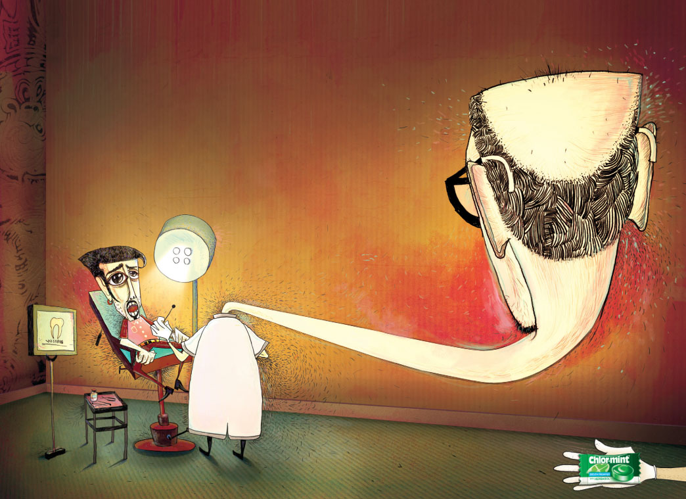
Learning Objective 4.2
Conditioning results in learning.
Notes:
Behavioral learning theories assume that learning takes place as the result of responses to external events. Psychologists who subscribe to this viewpoint do not focus on internal thought processes. Instead, they approach the mind as a “black box” and emphasize the observable aspects of behavior. The observable aspects consist of things that go into the box (the stimuli or events perceived from the outside world) and things that come out of the box (the responses, or reactions to these stimuli).

Slide 7
Theories of Learning
Behavioral learning theories focus on stimulus-response connections
Cognitive theories focus on consumers as problem solvers who learn when they observe relationships
Notes:
There are several learning theories which range from those that focus on connections between actions and consequences to those that focus on understanding complex relationships and problem solving.

Slide 8
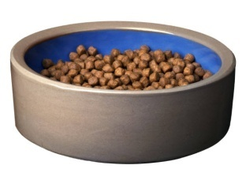



Types of Behavioral Learning Theories
Classical conditioning: a stimulus that elicits a response is paired with another stimulus that initially does not elicit a response on its own.
Instrumental conditioning (also, operant conditioning): the individual learns to perform behaviors that produce positive outcomes and to avoid those that yield negative outcomes.
Notes:
There are two theories which are types of behavioral learning theories: classical conditioning and instrumental conditioning.
Instrumental conditioning is also called operant conditioning. It means to condition behavior using consequences. It refers to voluntary behaviors, while classical conditioning works to condition responses to involuntary behaviors. We’ll cover more about classical conditioning on the next slide.

Slide 9
Classical Conditioning
Components of Conditioning
Unconditioned stimulus
Conditioned stimulus
Conditioned response
Conditioning Issues
Repetition
Stimulus generalization
Stimulus discrimination
Extinction
Notes:
Classical conditioning occurs when a stimulus that elicits a response is paired with another stimulus that initially does not elicit a response on its own. Over time, the second stimulus causes a similar response because we associate it with the first stimulus. Ivan Pavlov, a Russian physiologist who conducted research on digestion in animals, first demonstrated this phenomenon in dogs.
He paired a neutral stimulus (a bell) with a stimulus known to cause a salivation response in dogs. The powder was an unconditioned stimulus (UCS) because it was naturally capable of causing the response. Over time, the bell became a conditioned stimulus (CS). The bell did not initially cause salivation but the dogs learned to associate the bell with the meat powder and began to salivate at the sound of the bell only. The drooling of these canine consumers because of a sound was a conditioned response (CR).
Conditioning effects are more likely to occur after the conditioned (CS) and unconditioned (UCS) stimuli have been paired a number of times. This effect is known as repetition. Stimuli similar to a CS may evoke similar responses. This is known as stimulus generalization. Conditions may also weaken over time especially when a UCS does not follow a stimulus similar to a CS. This is called stimulus discrimination.

Slide 10
Stimulus
Stimulus generalization
Halo effect
Stimulus discrimination
Classical Conditioning Principle
Brand equity
Notes:
Stimulus generalization refers to the tendency of stimuli similar to a CS to evoke similar, conditioned responses. For example, Pavlov noticed in subsequent studies that his dogs would sometimes salivate when they heard noises that only vaguely resembled a bell, such as keys jangling.
People also react to other, similar stimuli in much the same way they responded to the original stimulus; we call this generalization a halo effect.
Stimulus discrimination occurs when a UCS does not follow a stimulus similar to a CS. When this happens, reactions weaken and will soon disappear.
Brand equity, in which a brand has strong positive associations in a consumer’s memory and commands a lot of loyalty as a result.

Slide 11
For Reflection (1 of 8)
How might classical conditioning operate for a consumer who visits a new tutoring Web site and is greeted by the Web site’s avatar who resembles Albert Einstein?

Slide 12
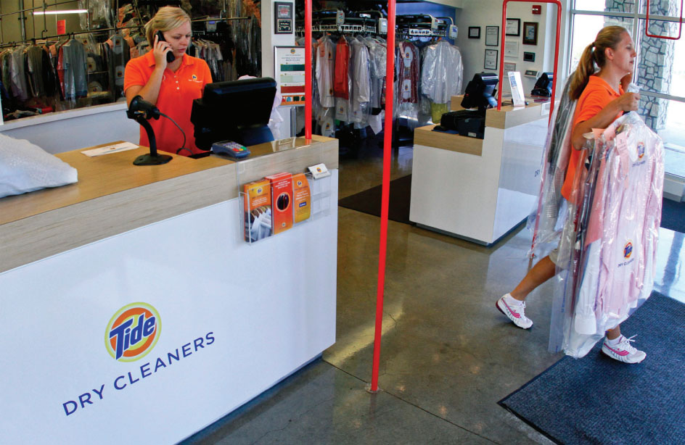
Learning Objective 4.3
Learned associations with brands generalize to other products.
Notes:
Behavioral learning principles apply to many consumer phenomena, such as creating a distinctive brand image or linking a
product to an underlying need. The transfer of meaning from an unconditioned stimulus to a conditioned stimulus explains why
“made-up” brand names, such as Marlboro, Coca-Cola, or Reebok, exert such powerful effects on consumers. The association between the Marlboro man and the cigarette is so strong that in some cases the company no longer even bothers to include the brand name in its ads that feature the cowboy riding off into the sunset.

Slide 13
Marketing Applications of Repetition
Repetition increases learning
More exposures = increased brand awareness
When exposure decreases, extinction occurs
However, too MUCH exposure leads to advertising wear out
Example: Izod crocodile on clothes
Notes:
Conditioning effects are more likely to occur after the conditioned stimulus (CS) and the unconditioned stimulus (UCS) have been paired several times. Repeated exposures to the association increase the strength of the associations and prevent decay of these associations in memory. Many classic advertising campaigns consist of product slogans repeated often to enhance recall. The Rolaids campaign which asked, ‘How do you spell relief? ROLAIDS’ is a personal favorite. But for this to work, the UCS must repeatedly be paired with the CS. Otherwise, extinction occurs. Extinction means that the association is forgotten.
Even when associations are established, too much exposure can turn negative. In that case, the association may change in terms of whether it is perceived as positive or negative. That’s what happened to Izod when its logo became too exposed on a variety of clothing and products.

Slide 14
Marketing Applications of Stimulus Generalization
Stimulus generalization: tendency for stimuli similar to a conditioned stimulus to evoke similar, unconditioned responses.
Family branding
Product line extensions
Licensing
Look-alike packaging
Notes:
The process of stimulus generalization is critical to branding and packaging decisions that try to capitalize on consumer’s positive associations with an existing brand or company name. Marketers can base some strategies on stimulus generalization. Family branding enables products to capitalize on the reputation of a company name. Marketers can use product line extensions by adding related products to an established brand. Licensing allows companies to rent well-known names. Distinctive packaging designs create strong associations with a particular brand. Companies that make generic or private-level brands and want to communicate a quality image often exploit this linkage when they put their products in similar packages to those of popular brands.

Slide 15
For Reflection (2 of 8)
Some advertisers use well-known songs to promote their products. They often pay more for the song than for original compositions. How do you react when one of your favorite songs turns up in a commercial?
Why do advertisers do this? How does this relate to learning theory?

Slide 16
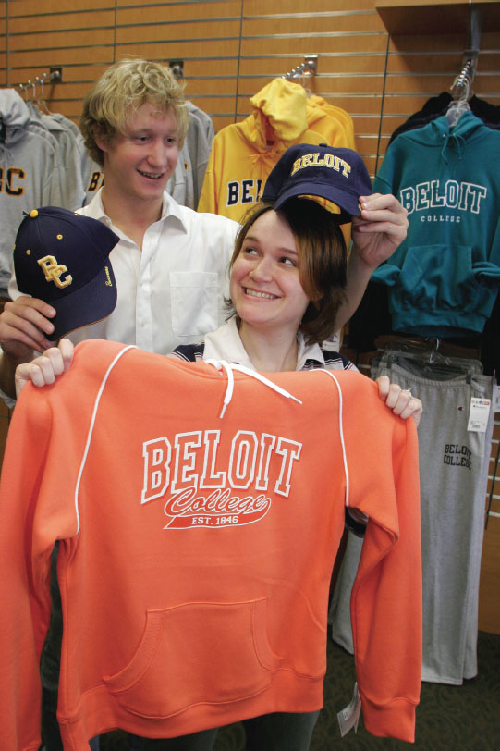
Learning Objective 4.4
There is a difference between classical and instrumental conditioning and both processes help consumers to learn about products.
Notes:
Instrumental conditioning (or operant conditioning ) occurs when we learn to perform behaviors that produce positive outcomes and avoid those that yield negative outcomes. We associate this learning process with the psychologist B. F. Skinner, who demonstrated the effects of instrumental conditioning
by teaching pigeons and other animals to dance and perform other activities when he systematically rewarded them for desired behaviors.
Responses to classical conditioning are fairly simple and involuntary, but the responses we make to instrumental conditioning are related to obtaining a goal. We may learn the desired behavior over a period of time as a shaping process rewards our intermediate actions. One way that instrumental conditioning may occur is through positive reinforcement. This is illustrated in the ad shown in the slide.

Slide 17
How Does Instrumental Conditioning Occur?
Positive reinforcement
Negative reinforcement
Punishment
Notes:
Instrumental conditioning (or operant conditioning) occurs when we learn to perform behaviors that produce positive outcomes and avoid those that yield negative outcomes. Whereas responses in classical conditioning are involuntary and fairly simple, we make those in instrumental conditioning deliberately to obtain a goal. We may learn the desired behavior over a period of time as a shaping process rewards our intermediate actions.
Instrumental conditioning occurs in one of three ways: 1) positive reinforcement, 2) negative reinforcement, and 3) punishment. Positive reinforcement comes in the form of a reward. Negative reinforcement shows how a negative outcome can be avoided. Punishment occurs when unpleasant events follow a response.
Extinction occurs when there is no reinforcement. In other words, the conditioning is not activated because it is not reinforced.

Slide 18
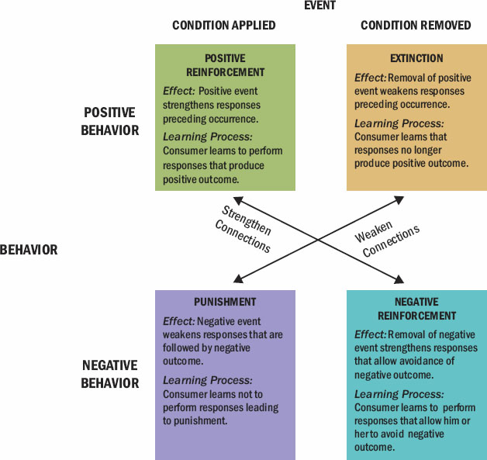
Figure 4.1 Types of Reinforcement
Notes:
This figure will help you to “reinforce” the relationships among these four conditions.
In addition to deciding whether to use positive reinforcement, negative reinforcement, or punishment, marketers also have to decide on a schedule. Marketers need to determine the most effective reinforcement schedule to use because this decision relates to the amount of effort and resources they must devote when they reward consumers who respond as they hope to their requests.
Several schedules are possible. In a fixed interval reinforcement, the first response made brings the reward and then on a specific set interval, future rewards are given. With variable interval reinforcement, one doesn’t know when the reward will be offered. Because you don’t know exactly when to expect the reinforcement, you have to respond at a consistent rate. In fixed ratio reinforcement, reinforcement only occurs after a fixed number of responses. The last type of reinforcement schedule is the variable-ratio schedule. This is the type of schedule used by slot machines.

Slide 19

Marketing Applications of Instrumental Conditioning Principles
Frequency marketing
Notes:
Instrumental conditioning (or operant conditioning) occurs when we learn to perform behaviors that produce positive outcomes and avoid those that yield negative outcomes. Whereas responses in classical conditioning are involuntary and fairly simple, we make those in instrumental conditioning deliberately to obtain a goal. We may learn the desired behavior over a period of time as a shaping process rewards our intermediate actions.
Instrumental conditioning occurs in one of three ways: 1) positive reinforcement, 2) negative reinforcement, and 3) punishment. Positive reinforcement comes in the form of a reward. Negative reinforcement shows how a negative outcome can be avoided. Punishment occurs when unpleasant events follow a response.
Extinction occurs when there is no reinforcement. In other words, the conditioning is not activated because it is not reinforced.

Slide 20
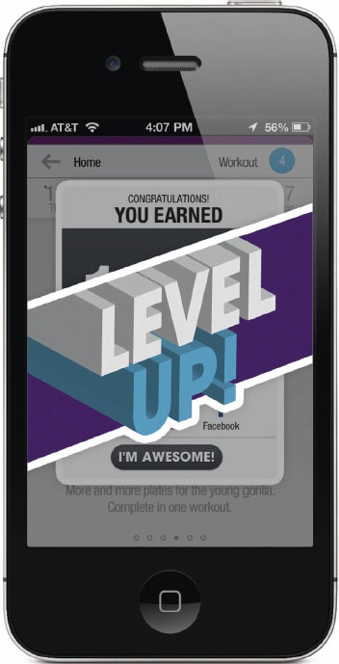
Gamification
Endowed progress effect
Store and brand loyalty
Social marketing
Employee performance
Notes:
The fast-growing strategy of gamification turns routine actions into experiences as it adds gaming elements to tasks that might otherwise be boring or routine.
Endowed progress effect, a carwash gave one set of customers a buy-eight-get-one-free card, while a second set of customers got a 10-wash card that had been punched twice.
A dynamic digital environment (whether in-store, on a laptop, or on a tablet or phone) that resembles a sophisticated videogame platform
Multiple short- and long-term goals
Rapid and frequent feedback
A reward for most or all efforts in the form of a badge or a virtual product
Friendly competition in a low-risk environment
A manageable degree of uncertainty
●● Store and brand loyalty. Foursquare gives people virtual badges when they check in
at a local cafe or restaurant. Some of them check in as often as they can to compete for
the honor of being named “mayor” of the location.
●● Social marketing. More than 75 utilities use a service from a company called
Opower that awards badges to customers when they reduce their energy consumption.
Customers can compare their progress with their neighbors’ and broadcast their
achievements on Facebook.
●● Employee performance. Some restaurants enlist a service called Objective Logistics
to rank the performances of waiters on a leaderboard, rewarding the good ones with
plum shifts and more lucrative tables.31

Slide 21

Cognitive Learning Theory
Internal learning processes

Slide 22
For Reflection (3 of 8)
What kind of reinforcement is being used when stores offer loyalty programs?
Provide several examples and identify the reinforcement approach being used.

Slide 23
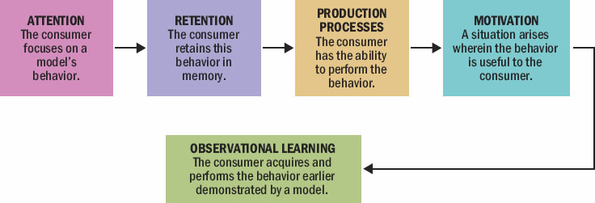
Learning Objective 4.5
We learn about products by observing others’ behavior.
Notes:
Observational learning occurs when we watch the actions of others and note the reinforcements they receive for their behaviors. In these situations, learning occurs as a result of vicarious rather than direct experience. People store these observations in memory as they accumulate knowledge and then they use this information at a later point to guide their own behavior. Modeling is the process of imitating the behavior of others.
In the figure illustrated, you can see that for a marketer to instigate observational learning, four conditions must be met. First, the consumer’s attention must be directed to the appropriate model and that person must be someone the consumer wishes to emulate. Second, the consumer must remember what the model says or does. Third, the consumer must convert this information into actions. Fourth, the consumer must be motivated to perform these actions.

Slide 24
Observational Learning
Social default and modeling
The consumer’s attention must be directed to the appropriate model.
The consumer must remember what the model says or does.
The consumer must convert this information into actions.
The consumer must be motivated to perform these actions.
Notes:
Observational learning occurs when we watch the actions of others and note the reinforcements they receive for their behaviors. In these situations, learning occurs as a result of vicarious rather than direct experience. This type of learning is a complex process; people store these observations in memory as they accumulate knowledge and then they use this information at a later point to guide their own behavior. Particularly when we are preoccupied with other demands, we are likely to mimic others’ behaviors as a social default.
Modeling (not the runway kind) is the process of imitating the behavior of others

Slide 25

How Do We Learn to Be Consumers?
Consumer socialization
Parent’s influence
Authoritarian
Neglecting
Indulgent
Notes:
Parents exhibit different styles when they socialize their children. They may be authoritarian, neglecting, or indulgent.
Authoritarian parents are hostile, restrictive, and emotionally uninvolved.
Neglecting parents are detached from their children and don’t exercise much control over what the children do.
Indulgent parents communicate more with their children about consumption-related matters and are less restrictive.

Slide 26
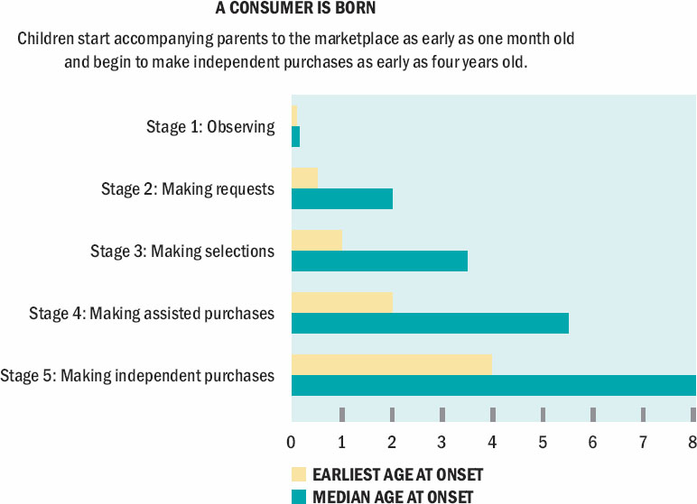
Figure 4.3 Five Stages of Consumer Development
Notes:
The process of consumer socialization begins with infants. Within the first two years, children request products they want. By about age 5, most kids make purchases with the help of parents and grandparents. The figure shows the sequence of stages as kids turn into consumers.

Slide 27
Cognitive Development
Limited
Cued
Strategic
Multiple-intelligence theory
Notes:
1 Limited—Children who are younger than age 6 do not employ storage-and-retrieval
strategies.
2 Cued—Children between the ages of 6 and 12 employ these strategies but only when
prompted to do so.
3 Strategic—Children 12 and older spontaneously employ storage-and-retrieval
strategies.
Multiple-intelligence theory. This influential perspective argues for other types of intelligence, such as athletic prowess or musical ability, beyond the traditional math and verbal skills psychologists use to measure IQ.

Slide 28
For Reflection (4 of 8)
How did your parents influence your development as a consumer?
How much freedom were you provided in terms of your consumer choices?

Slide 29
Learning Objective 4.6
Our brains process information about brands to retain them in memory.
Notes:
Memory is a process of acquiring information and storing it over time so that it will be available when we need it. Many people assume the mind works with an information processing approach. Data are input, processed, and output for later use in revised form. In the encoding stage, information enters in a way the system will recognize. In the storage stage, we integrate this knowledge with what is already in memory and “warehouse” it until it is needed. During retrieval, we access the desired information. Figure 3.3 summarizes the memory process.

Slide 30

Memory
Encoding
Storage stage
Retrieval
Episodic memories
Narrative
Activation models of memory
Notes:
1 In the encoding stage, information enters in a way the system will recognize.
2 In the storage stage, we integrate this knowledge with what is already in memory and “warehouse” it until it is needed.
3 During retrieval, we access the desired information
Episodic memories relate to events that are personally relevant
A narrative, or a description of a product that is written as a story, is often an effective way to convey product information
activation models of memory explain that depending on the nature of the processing task different levels of processing occur that activate some aspects of memory rather than others.

Slide 31
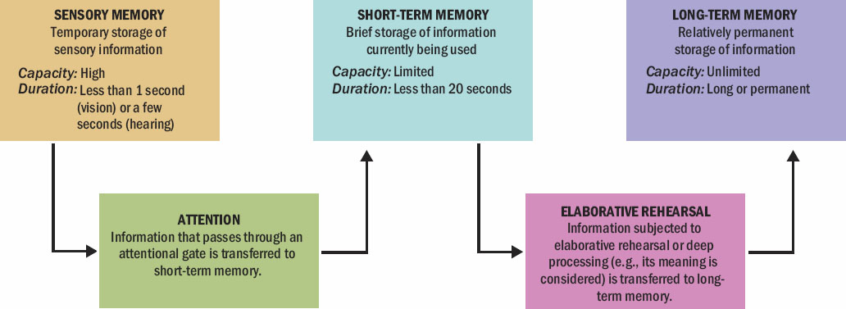
Memory Systems
Notes:
According to the information-processing perspective, there are three distinct memory systems: sensory memory, short-term memory, and long-term memory. Each plays a role in processing brand-related information, as summarized in the figure.
Sensory memory stores the information we receive from our senses. This storage is temporary. If the information is retained for further processing, it passes through an attentional gate and transfers to short-term memory. Short-term memory also stores information for a limited period of time, and it has limited capacity. This system is working memory. It holds information we are currently processing. Our memories can store verbal input acoustically or semantically. We store this information by combining small pieces into larger ones in a process we call chunking. A chunk is a configuration that is familiar and the person can think about it as a unit. Long-term memory is the system that allows us to retain information for a long period of time. A cognitive process we call elaborative rehearsal allows information to move from short-term memory to long-term memory.

Slide 32
For Reflection (5 of 8)
What’s a memory that you just can’t seem to forget (bonus, if you think of one related to a brand)?
Now that you know the types of memory and how your mind stores information, why do you think the memory stays with you?

Slide 33
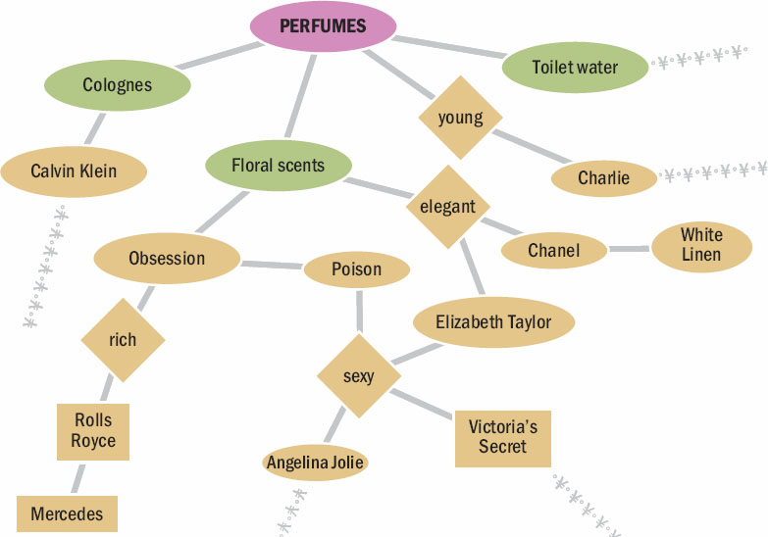
Learning Objective 4.7
The other products we associate with an individual product influence how we will remember it.
Notes:
Recent research suggests that long-term memory and short-term memory are interdependent systems. Depending on the nature of the processing task, different levels of processing occur that activate some aspects of memory rather than others. These approaches are called activation models of memory. The more effort it takes to process information, the more likely it is that information will transfer into long-term memory.
According to these activation models of memory, an incoming piece of information gets stored in an associative network that contains many bits of information. These storage units are knowledge structures – like a complex spider web filled with pieces of data. Incoming information gets put into nodes that connect to one another. Figure 4.6 shows an associative network for perfumes.

Slide 34
Spreading Activation
Brand-specific
Ad-specific
Brand identification
Product category
Evaluative reactions
Notes:
A marketing message may activate our memory of a brand directly or indirectly. If it activates a node, it will also activate other linked nodes much as tapping a spider’s web in one spot sends movement reverberating across the web. The process of spreading activation allows us to shift back and forth among levels of meaning. The way we store a piece of information in memory depends on the type of meaning we initially assign to it. This meaning type then determines how and when something activates the meaning.
The meaning types are listed in the slide. Brand-specific meaning refers to memory stored in terms of the claims the brand makes. Ad-specific meaning refers to memories stored in terms of the medium or content of the ad itself. Brand identification is memory stored in terms of the brand name. Product category meaning is memory stored in terms of how the product works or where it should be used. Evaluative reactions is memory stored as positive or negative emotions.
Within a knowledge structure, we code elements at different levels of abstraction and complexity. Meaning concepts (like “macho”) get stored as individual nodes. We may combine these concepts into a larger unit we call a proposition or a belief. A proposition links two nodes together to form a more complex meaning. For example, “Axe is cologne for macho men” is a proposition. One type of schema that is especially relevant to consumer behavior is a script. A script is a sequence of events an individual expects to occur.

Slide 35

Levels of Knowledge
Schema
Script
Service scripts
Notes:
A schema is a cognitive framework we develop through experience.
Script is a sequence of events an individual expects to occur. As consumers we learn service scripts that guide our behavior in commercial settings.

Slide 36
Retrieving Memories
Pioneering brand
Follower brands
Spacing effect
Notes:
Pioneering brand is the first brand to enter a market.
Follower brands that ride their coattails because the first product’sintroduction is likely to be distinctive, and for the time being, no competitors divert our attention.
Spacing effect describes the tendency for us to recall printed material more effectively when the advertiser repeats the target item periodically, rather than presenting it repeatedly in a short time period

Slide 37
Forgetting
Decay
Interference
State-dependent retrieval
Highlighting effect
Salience
Von Restorff effect
Mixed and Unipolar emotions
Hybrid Ads
Notes:
In a process of decay, the structural changes that learning produces in the brain simply go away. Forgetting also occurs as a result of interference; as we learn additional information,
it displaces the previous information.
The phenomenon of state-dependent retrieval illustrates that we are better able to access information if our internal state is the same at the time of recall as when we learned the information.
highlighting effect, which occurs when the order in which consumers learn about brands determines the strength of association between these brands and their attributes.
The salience of a brand refers to its prominence or level of activation in memory
The von Restorff Effect is well-known to memory researchers; it shows that almost any technique that increases the novelty of a stimulus also improves recall.
We recall mixed emotions (e.g., those with positive and negative components) differently than unipolar emotions that are either wholly positive or wholly negative.
Hybrid ads include a program tie-in

Slide 38
Learning Objective 4.8
Marketers measure our memories about products and ads.

Slide 39
Measuring Memory for Marketing Stimuli
Recognition versus recall
Problems with memory measures
Response biases
Memory lapses
Omitting
Averaging
Telescoping
Illusion of truth effect
Notes:
How do we know if our marketing messages are designed to help consumer remember them? We can measure recognition and recall. In a typical recognition test, researchers show ads to subjects one at a time and ask if they have seen them before. In contrast, free recall tests ask consumers to independently think of what they have seen without being prompted first. Of course, measures of memory can be faulty. For one, they may be contaminated by response biases. For example, people tend to give yes responses to questions regardless of the question. People also suffer from memory lapses. Typical problems include omitting facts, averaging (or normalizing the memories by not reporting extreme cases), and telescoping (inaccurate recall of time).
The illusion of truth effect may occur as well. This effect refers to the phenomenon of people remembering a claim is true when they have been told the claim is false.

Slide 40
For Reflection (7 of 8)
List three of your favorite foods.
What memories do you have associated with these foods?
Are the foods associated with specific family events like a gathering for St. Patrick’s Day? Explain.

Slide 41
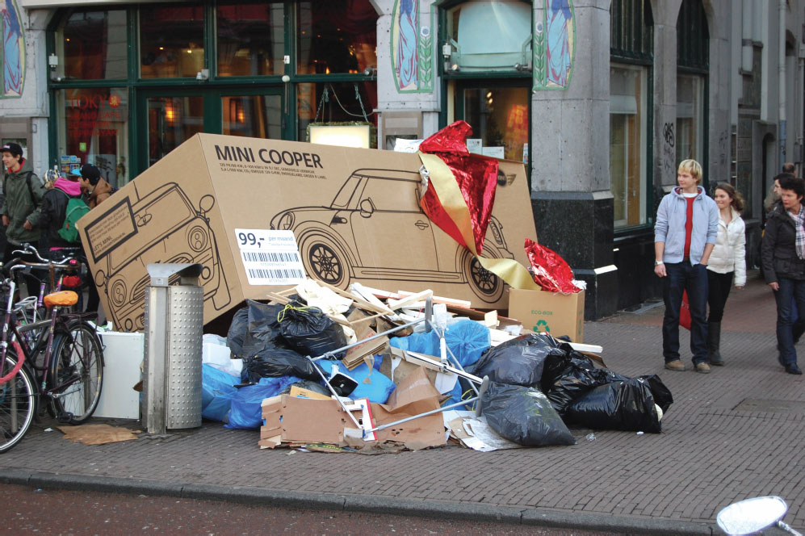
Learning Objective 4.9
Products help us to retrieve memories from our past.
Notes:
Retrieval is the process whereby we recover information from long-term memory. Many things affect our ability to retrieve information. One of those is how the marketer presents the information.

Slide 42
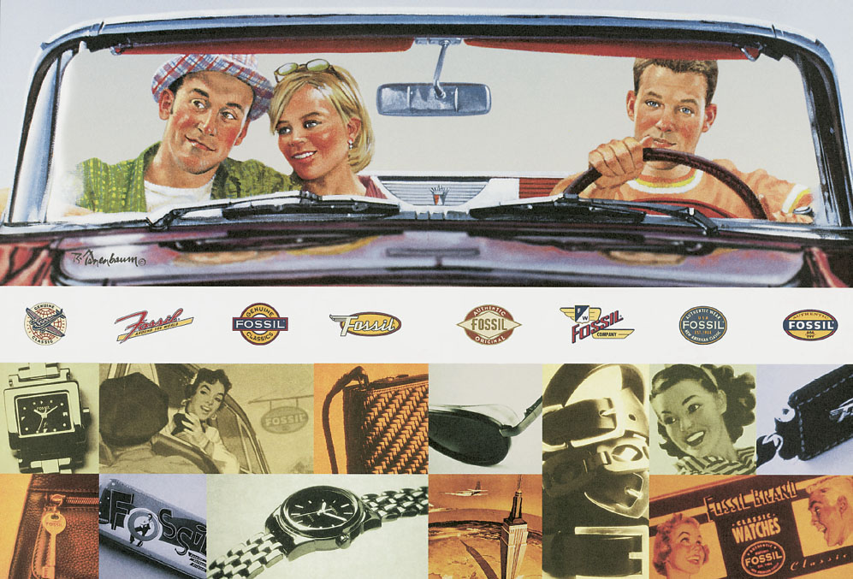
The Marketing Power of Nostalgia
Marketers may resurrect popular characters to evoke fond memories of the past.
Nostalgia
Retro brand
Notes:
Nostalgia describes the emotions where we view the past with longing. We reference the good old days. When marketers play on nostalgia, they want us to attach our fond memories to new products. One way to do this is to introduce retro brands. A retro brand is an updated version of a brand from a prior historical period. The Mini Cooper, PT Cruiser, and Volkswagon’s New Beetle are all retro brands.

Slide 43
For Reflection (8 of 8)
What “retro brands” are targeted to you? Were these brands that were once used by your parents?
What newer brands focus on nostalgia, even though they never existed before?

Slide 44
Chapter Summary
Marketers need to know how consumers learn in order to develop effective messages.
Conditioning results in learning and learned associations can generalize to other things.
Learning can be accomplished through classical and instrumental conditioning and through observing the behavior of others.
We use memory systems to store and retrieve information.

Slide 45

Copyright

